Slide 1
Retail_Business_Tableau_Project
File created on: 04-03-2026 17:59:30

Slide 2


Slide 3


Slide 4


Slide 5
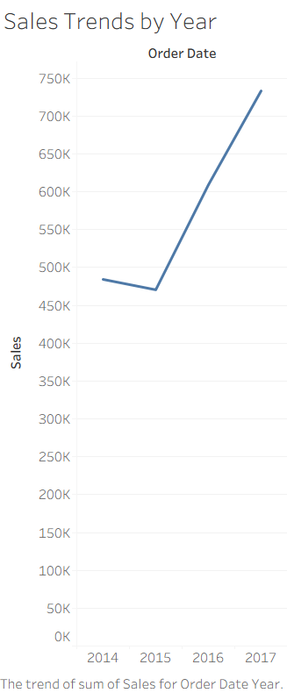

Slide 6
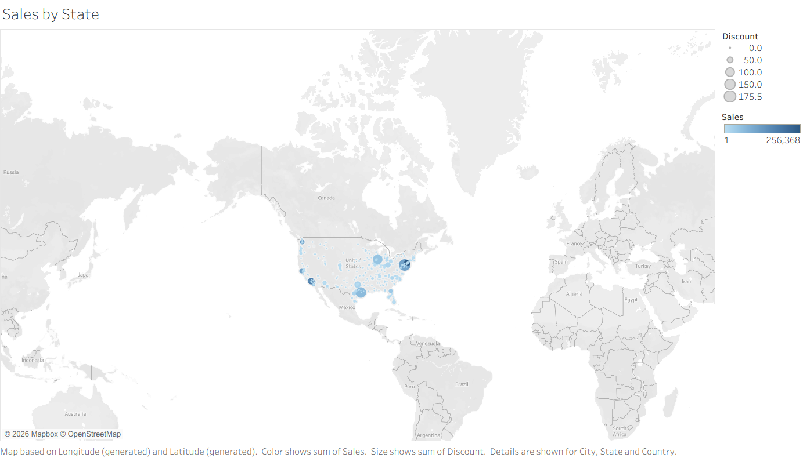

Slide 7
